Slide 1


Lesson 16
Save the Animals, Save the Earth
UNIT 4

Slide 2
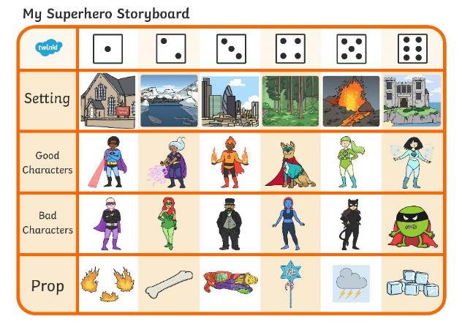
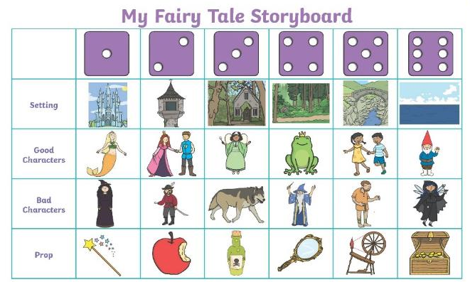
Roll of the Dice Story
Choose one of the storyboards. Roll a dice four times - once for each row.
Select the element from each row which corresponds to the number rolled. Then, use all the elements to make a story.

Slide 3
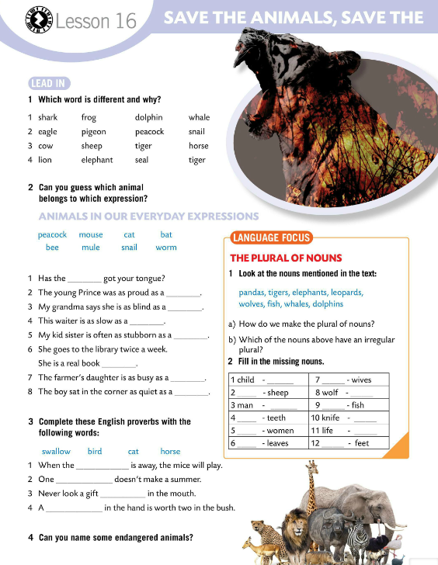
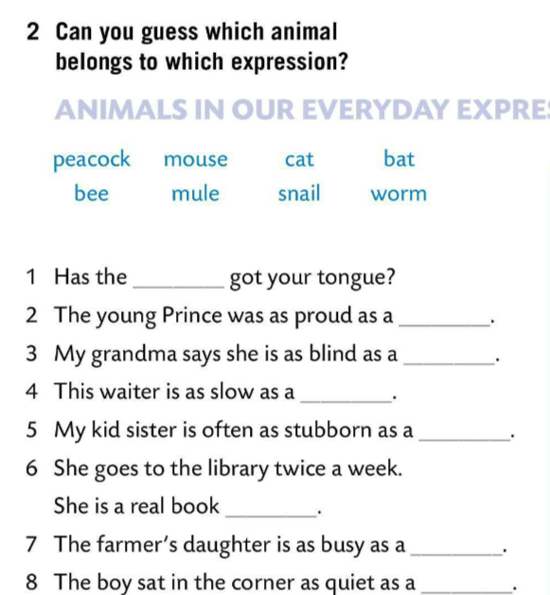
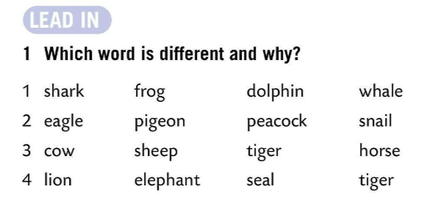
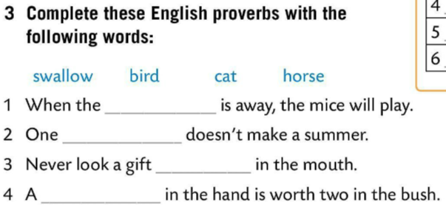
Which word is different and why?
Check.
Can you guess which animal belongs to which expression?
Check.
cat
cat
peacock
Complete these English proverbs with the words from Task 3.
swallow
bat
horse
snail
bird
mule
Check.
worm
bee
mouse
Can you name some endangered animals?

Slide 4
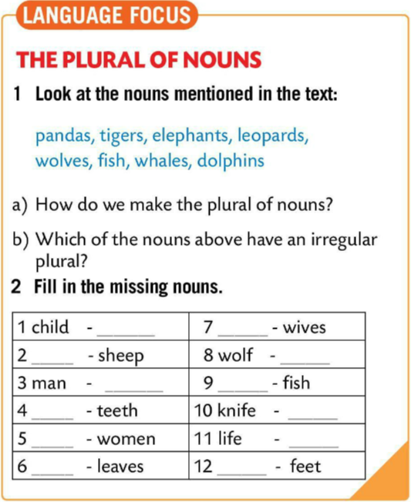
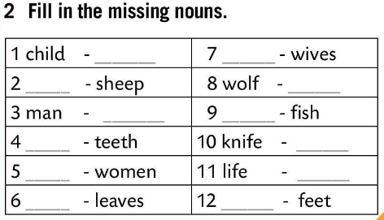
LANGUAGE FOCUS
How do we make the plural of the nouns?
- we add -s to the end
- if the singular noun ends in ‑s, -ss, -sh, -ch, -x, or –z, we add ‑es to the end
- If the singular noun ends in -f or -fe:
-f/-fe -v+es / -ve+s
wolf-wolves / wife-wives
Which of the nouns above have an irregular plural?
Fish.
children
wife
sheep
wolves
men
fish
tooth
knives
woman
lives
Fill in the missing nouns.
leaf
foot
Check.
Play a game! ☺
https://learningapps.org/watch?v=pfaq707wn20

Slide 5
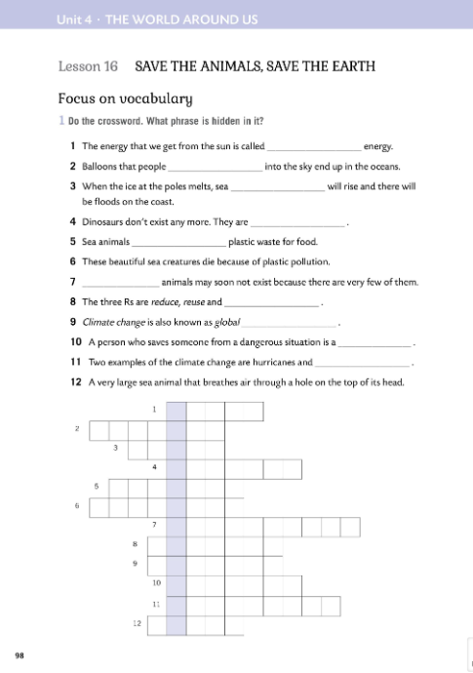

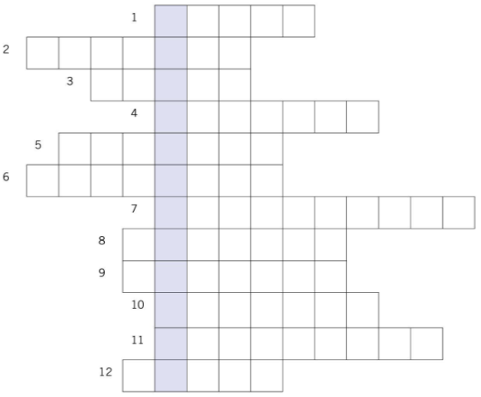
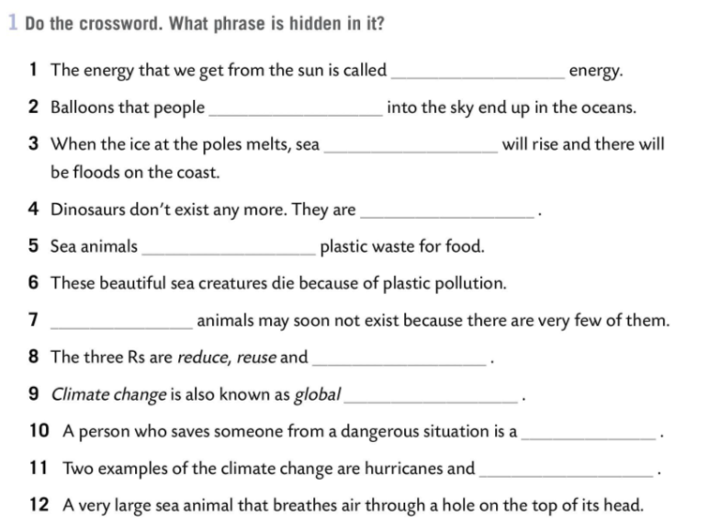
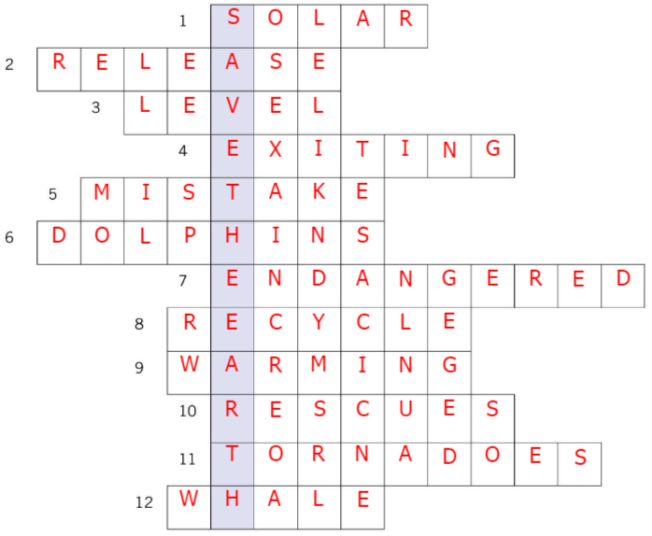
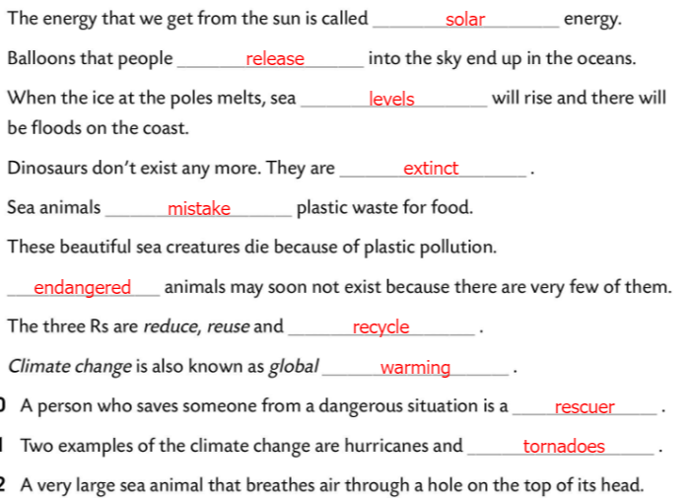
Workbook, page 98
Do the crossword. What phrase is hidden in it?
Check.

Slide 6
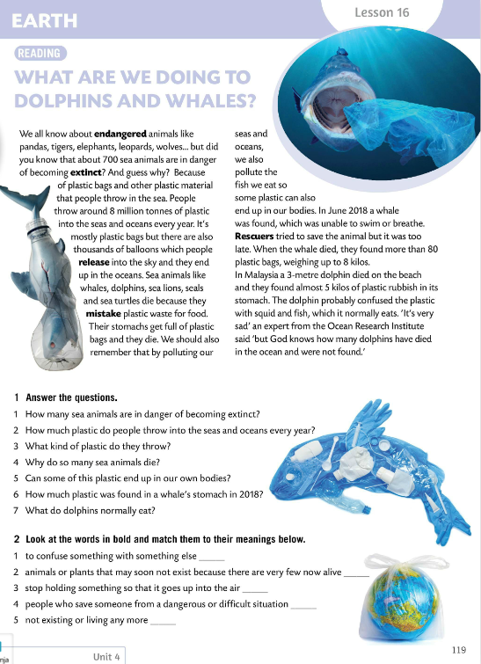
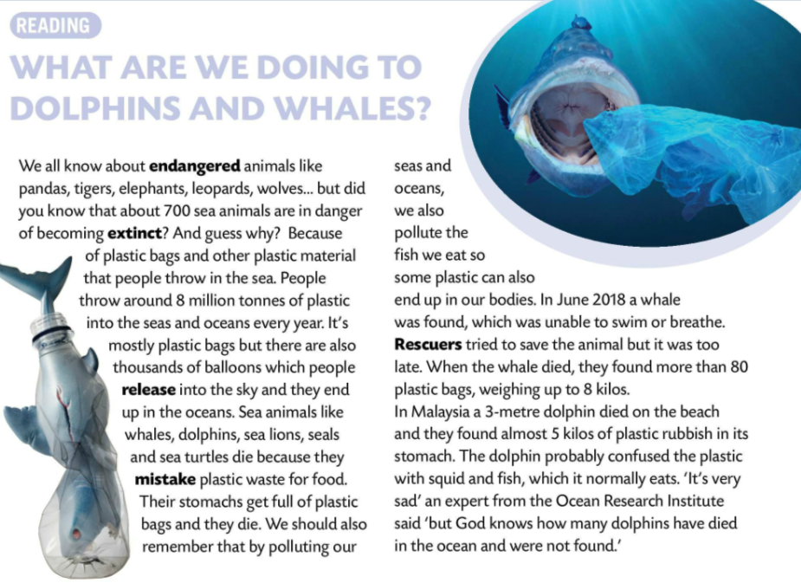
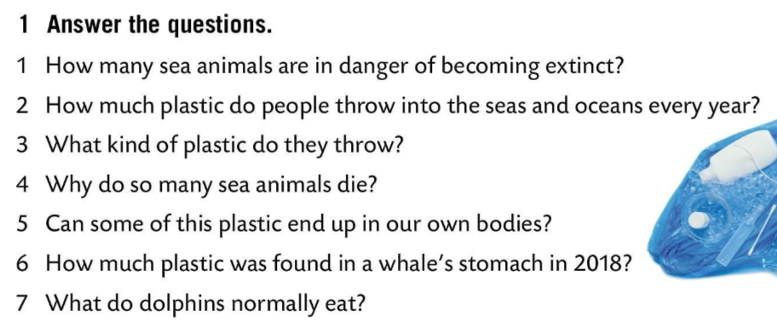
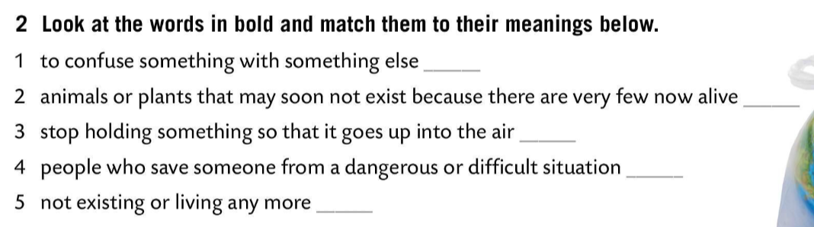
Read the text and answer the questions.
1 About 700 sea animals are becoming extinct.
2 People throw around 8 million tonnes of plastic into seas every year.
3 Sea animals die because they mistake plastic waste for food.
4 Yes, it can.
5 About 8 kilos of plastic was found in a whale’s stomach in 2018.
6 Dolphins normally eat squid and fish.
mistake
endangered
release
rescuers
extinct
Look at the words in bold and match them to their meanings below.
Check.

Slide 7
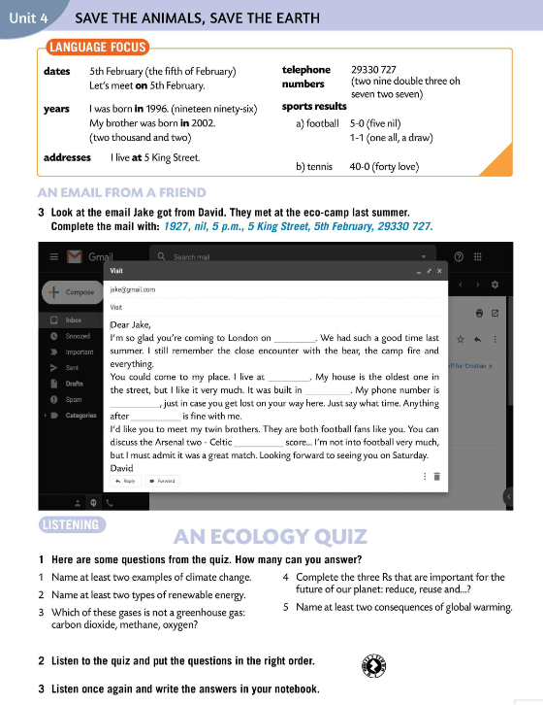
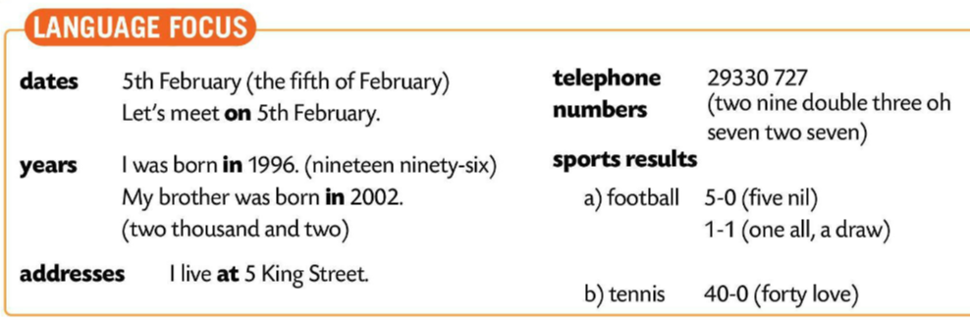
LANGUAGE FOCUS
DATES - ON
Let’s meet on 5th of February.
YEARS - IN
l was born in 1996.
ADDRESS - AT
I live at 5 King Street.
We pronounce 0:
‘oh’ - when we read a telephone number
‘nil’ - in sports (football), for 5-0 we say ‘five nil’
- ‘love’ - in tennis, for 40-0 we say ‘forty-love’

Slide 8
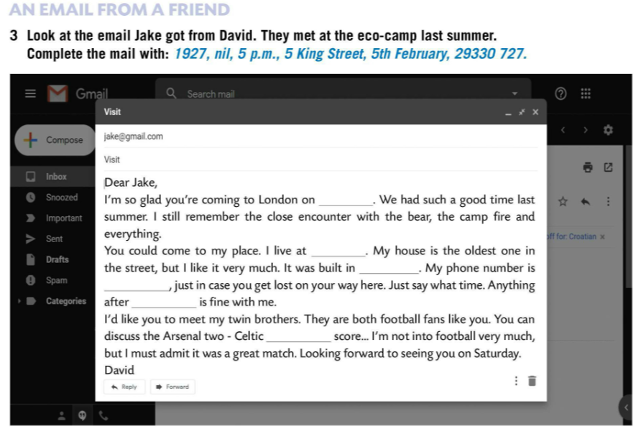
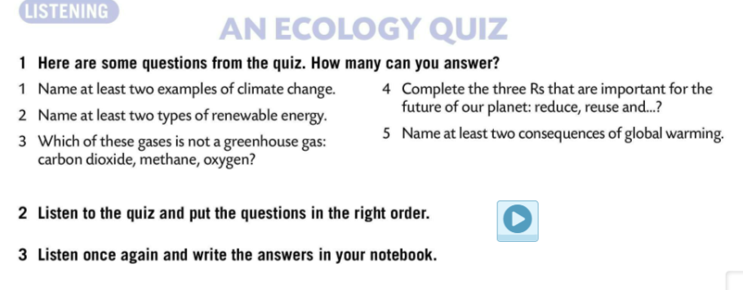
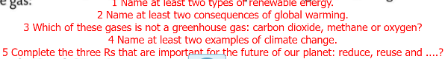

Look at the email Jake got from David.
Complete the mail with:
1927, nil, 5 p.m., 5 King Street, 5th February, 29330 727.
Check.
5th February
Here are some questions from the quiz. How many can you answer?
5 King Street
1972
29330 727
5 p.m.
Listen to the quiz and put the questions in the right order.
nil
Check.
Listen again and write the answers in your notebook.

Slide 9
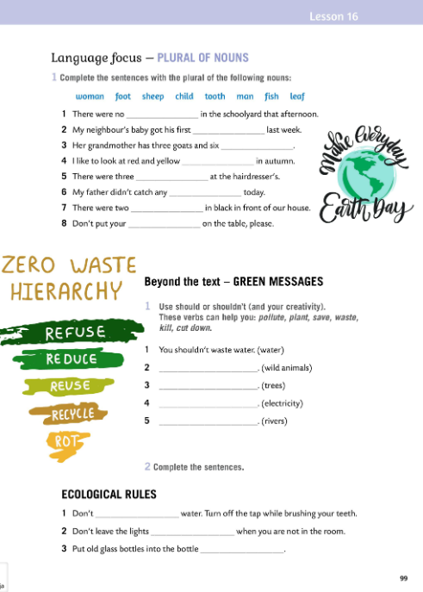
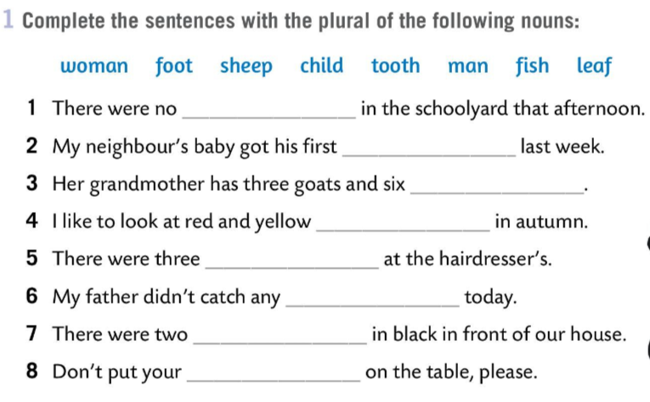
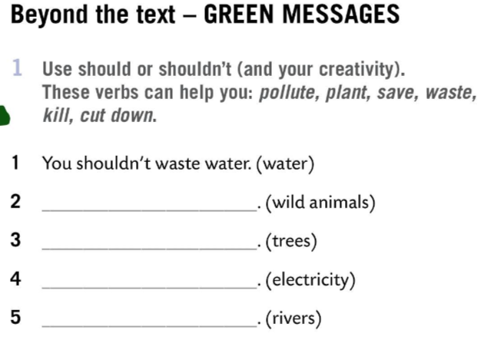
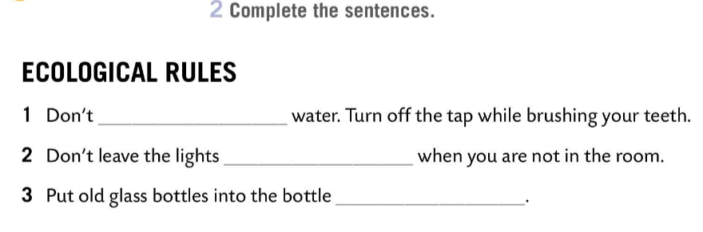
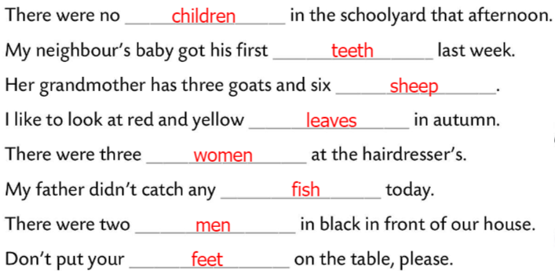
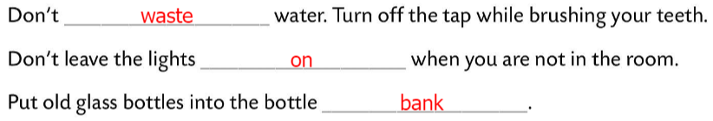
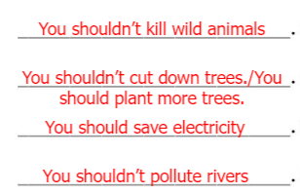
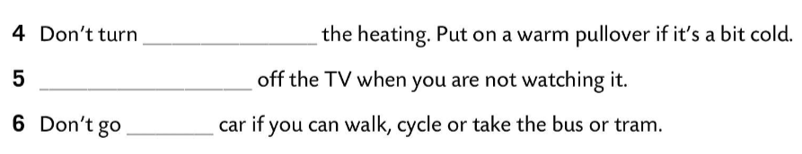
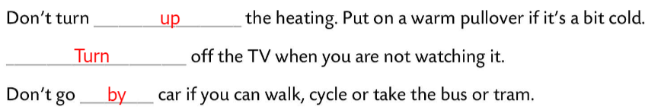
Workbook, page 99
Complete the sentences with the plural of the nouns.
Check.
Use should or shouldn’t. These verbs can help you (polite, paint, save, waste, cut down, kill).
Check.
Complete the sentences.
Check.

Slide 10
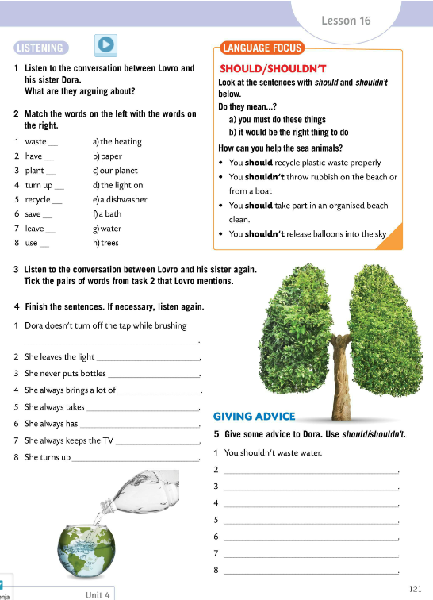
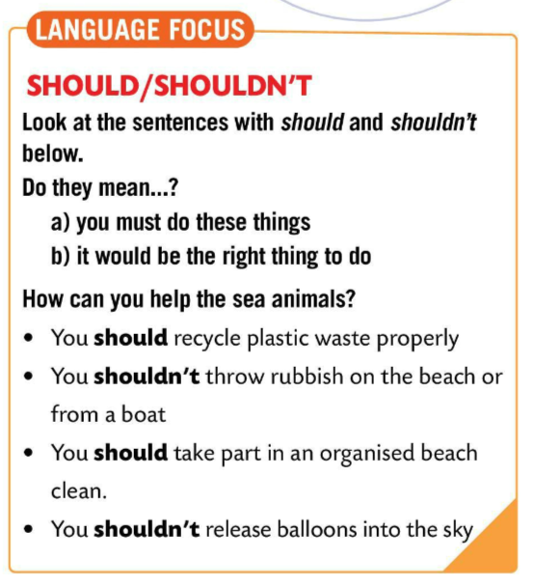
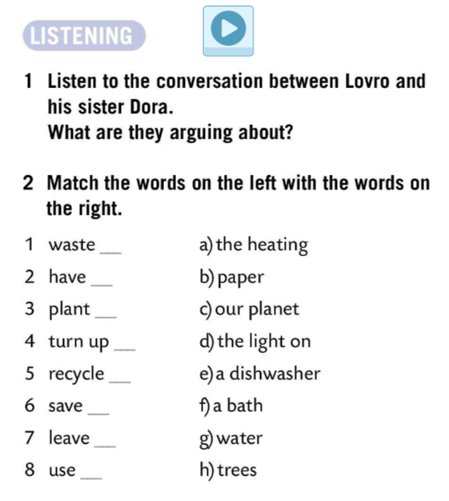
Listen to the conversation between Lovro and his sister Dora.
What are they arguing about?
Match the words on the left with the words on the right.
We use should to give advice or make suggestions. Also, to make recommendations or give advice. It can also be used to express obligation as well as expectations.
Should koristimo kada pričamo o nečemu za što mi mislimo da je ispravno, kada dajemo ili tražimo savjet ili prijedlog. Može se koristiti za izražavanje obaveza i očekivanja.
Look at the sentences with should and shouldn’t in LANGUAGE FOCUS box.
What do they mean?
g)
f)
h)
a)
b)
c)
Listen to the conversation between Lovro and his sister again. Tick the pairs of words from Task 2 that Lovro mentions.
d)
e)
Check.

Slide 11
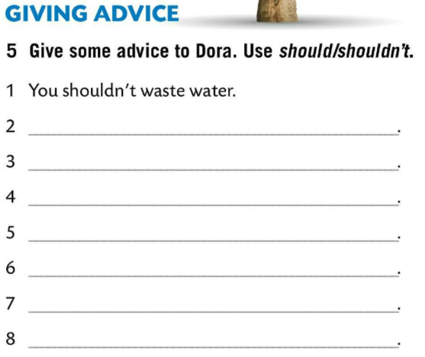
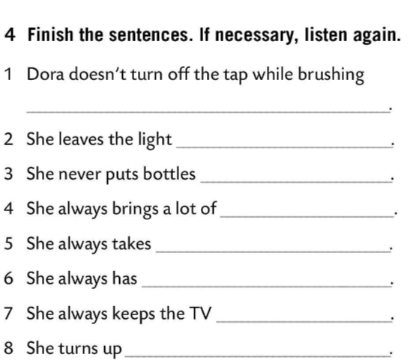
Finish the sentences. If necessary, listen again.
Check.
Give some advice to Dora. Use should/ shouldn’t.
her teeth
on in her room
in the bottle bank
Check.
plastic bags home
a bus to school
a bath and not a shower
on standby
the heating instead of putting a cardigan
Play a game! ☺
https://wordwall.net/play/853/945/220

Slide 12
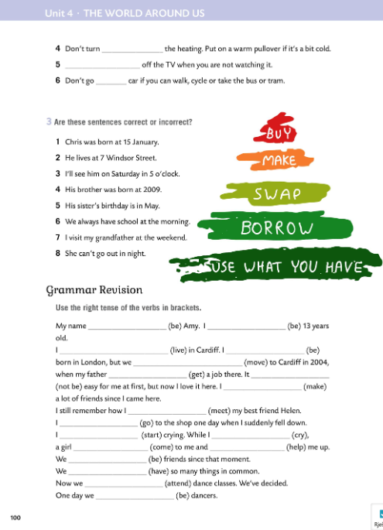
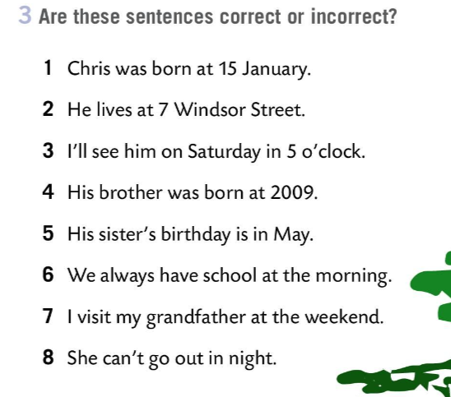
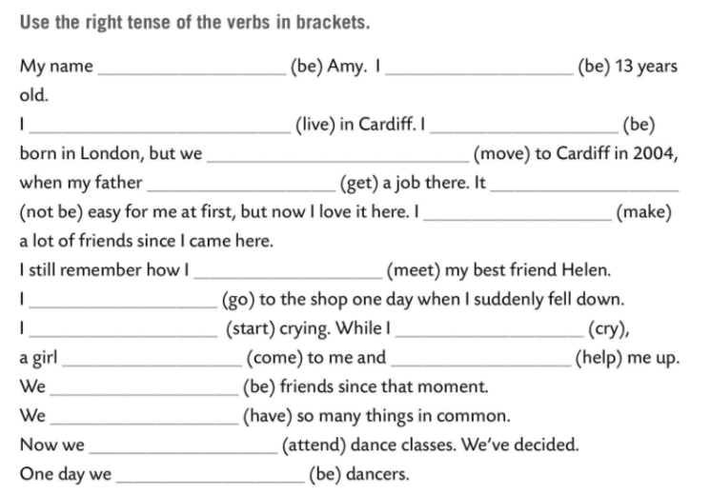
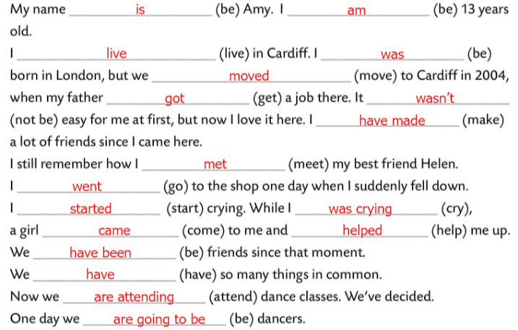
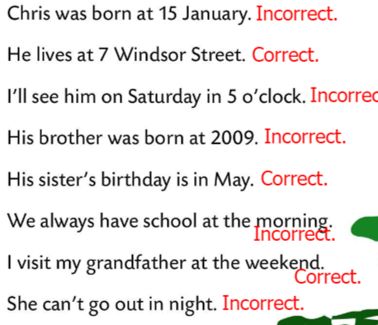
Workbook, page 100
Are these sentences correct or incorrect.
Check.
Use the right tense of the verbs in brackets.
Check.

